Slide 1



Slide 2


Md. Foysal Sheikh
221-15-4865 Md Mehedi Hasan Nayeem
221-15-5049 Tamanna Akter 221-15-5298 Mahamudul hasan
Id 221-15-6013
Md Shafiqul Islam

Slide 3
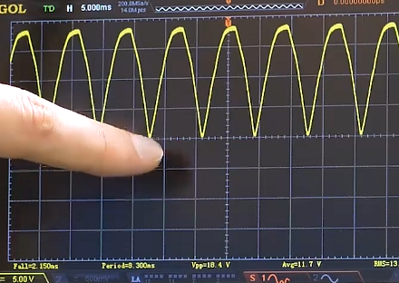
Presentation topic name:
Full wave rectifier

Slide 4
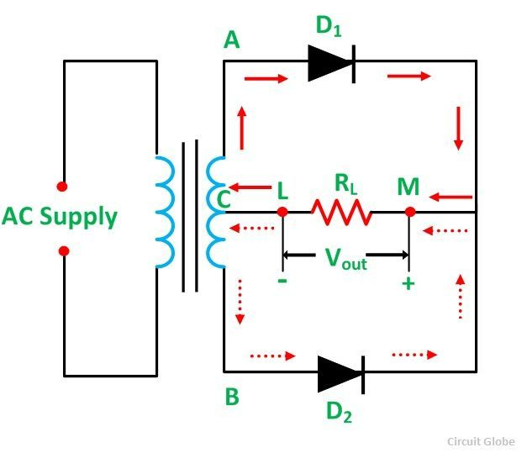
Centre-Tap Full-Wave Rectifier
A rectifier circuit whose transformer secondary is tapped to get the desired output voltage, using two diodes alternatively, to rectify the complete cycle is called as a Center-tapped Full wave rectifier circuit.

Slide 5
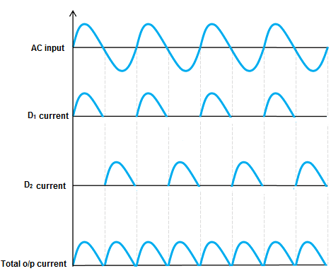
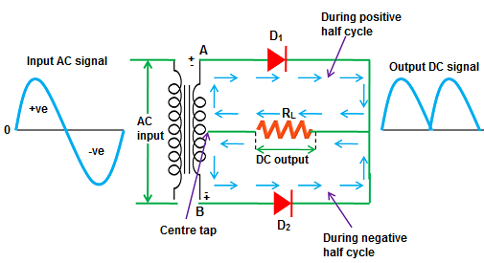
Operation :

Slide 6
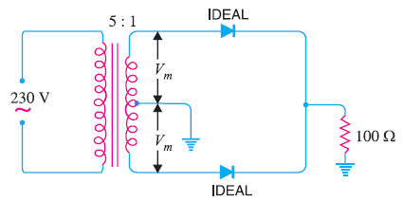
Peak inverse voltage :
the peak inverse voltage is twice the maximum voltage across the half-secondary winding i.e.
PIV = 2 Vm

Slide 7
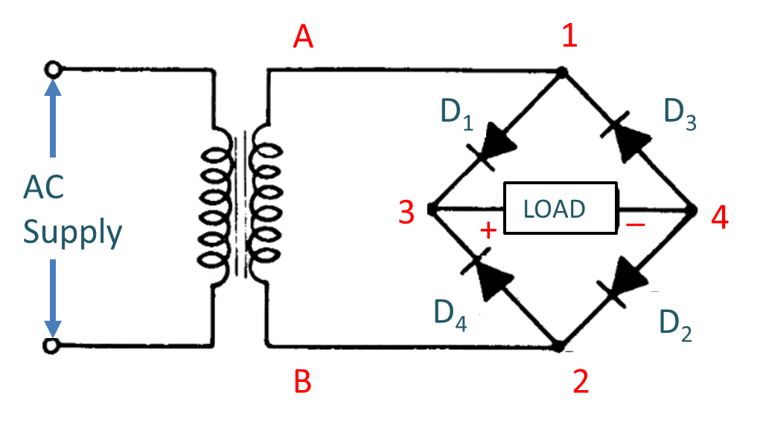
Full-Wave Bridge Rectifier

Slide 8
Operation

Slide 10
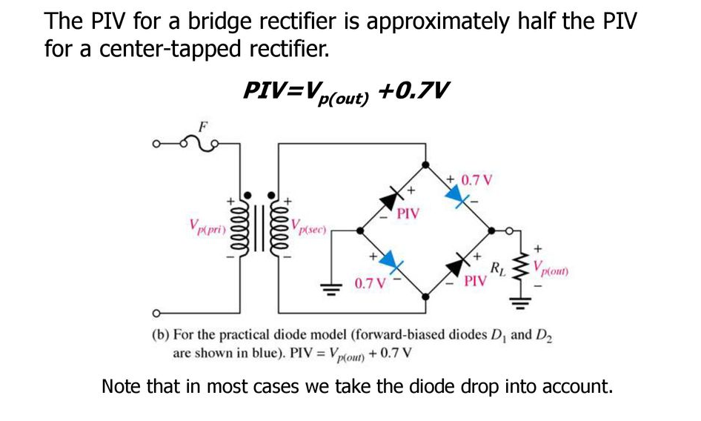
Peak inverse voltage

Slide 11
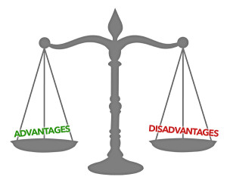
Advantages
(i) The need for centre-tapped transformer is eliminated.
(ii) The output is twice that of the centre-tap circuit for the same secondary voltage.
(iii) The PIV is one-half that of the centre-tap circuit (for same d.c. output).
Disadvantages
(i) It requires four diodes.

Slide 12
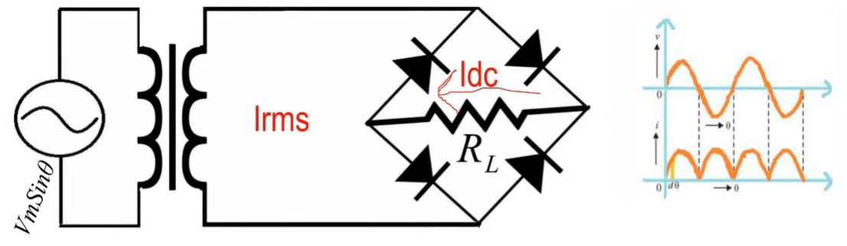
Efficiency:
Rectifier efficiency is the ratio of output DC power to the input AC power

Slide 13
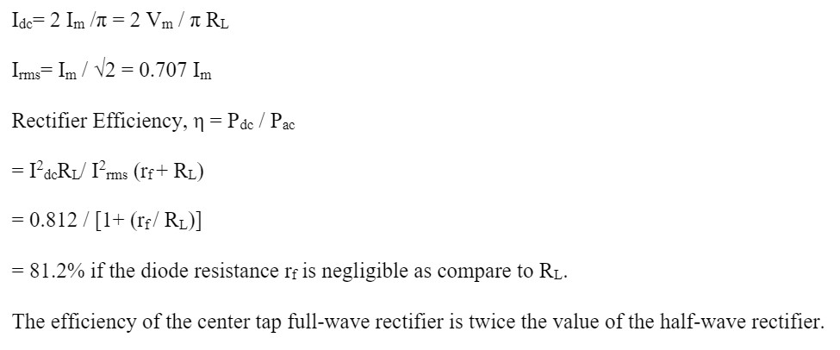

Slide 14


